Slide 1
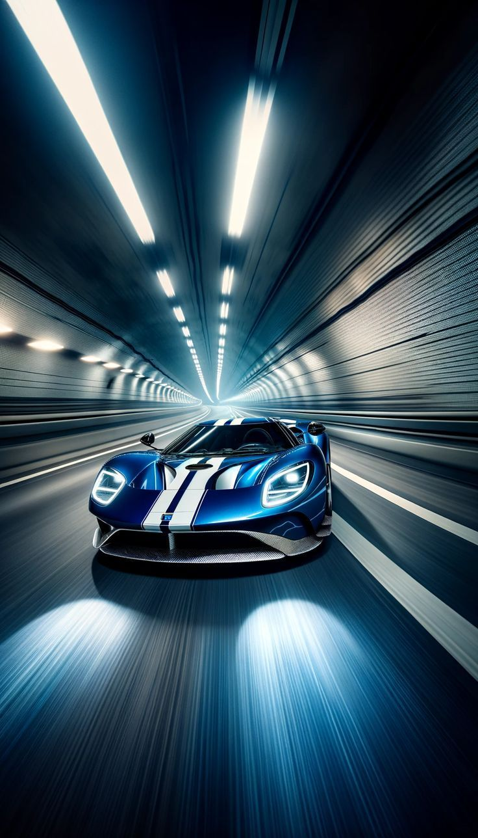
Garvin’s Eight Dimensions of Quality
Team Dynamics – D6
Presented By:
Surya Kiran
Biswanath
Vikyath
Lasya
Diksha
Percy
Notes:
• The key strengths of each brand in the luxury car market cater to diverse customer preferences, meeting the unique needs of different segments. • While the brands demonstrate strong capabilities, there are also areas with potential for enhancement that could further improve the customer experience. • The luxury car market is undergoing significant evolution driven by technological advancements and changing consumer demands. It's important to stay attuned to these market trends. • In addition to the strengths and weaknesses identified, the analysis also uncovered several opportunities for the brands to capitalize on and strengthen their competitive positioning.

Slide 2
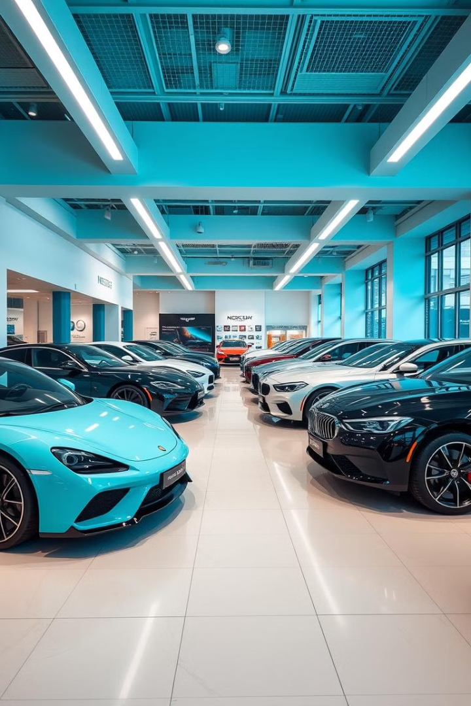
Luxury Car Brand Comparison: Using Garvin's Eight Dimensions of Quality
This presentation explores the competitive landscape of the luxury car market by analyzing eight key dimensions of quality, based on David Garvin's framework.

Slide 3
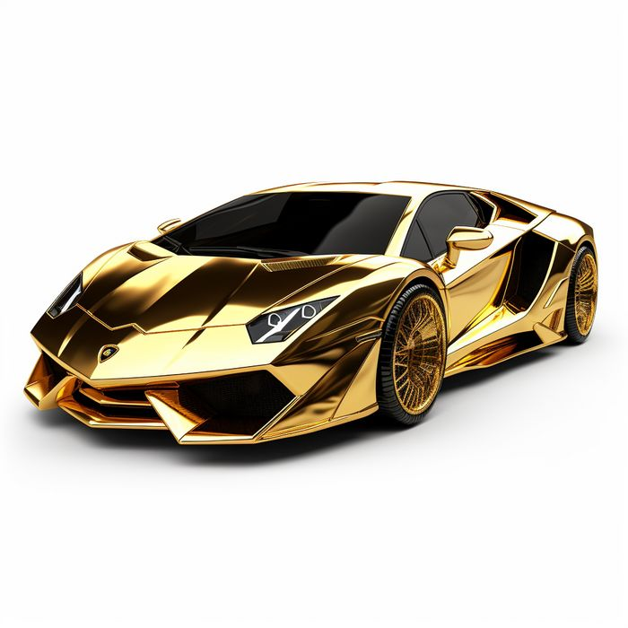
Introduction to the Luxury Car Market
Premium Features
Key Players
Luxury car brands are known for their superior comfort, performance, and technology, catering to discerning buyers.
Leading brands include BMW, Mercedes-Benz, Audi, each with distinct strengths and target audiences.

Slide 4
Garvin's Eight Dimensions of Quality
1
Performance
2
Features
Engine power, acceleration, handling, and braking efficiency.
Advanced safety systems, infotainment features, and luxury amenities.
3
Reliability
4
Conformance
Consistent performance, low maintenance requirements, and infrequent breakdowns.
Accuracy of manufacturing, adherence to design specifications, and consistent quality.
5
Durability
6
Serviceability
Resistance to wear and tear, longevity of components, and resilience over time.
Ease of repair, availability of parts, and promptness of service.
7
Aesthetics
8
Perceived Quality
Exterior and interior design, visual appeal, and overall attractiveness.
Brand reputation, customer perception, and perceived value for money.

Slide 5

Evaluation Matrix and Scoring Methodology
Dimension
BMW
Mercedes-Benz
Audi
Performance
5
5
4.5
Features
5
5
4.5
Reliability
5
4.5
4.5
Conformance
5
5
5
Durability
4.5
4.5
4
Serviceability
4.5
4.5
4.5
Aesthetics
5
5
4.5
Perceived Quality
5
5
4.5

Slide 6
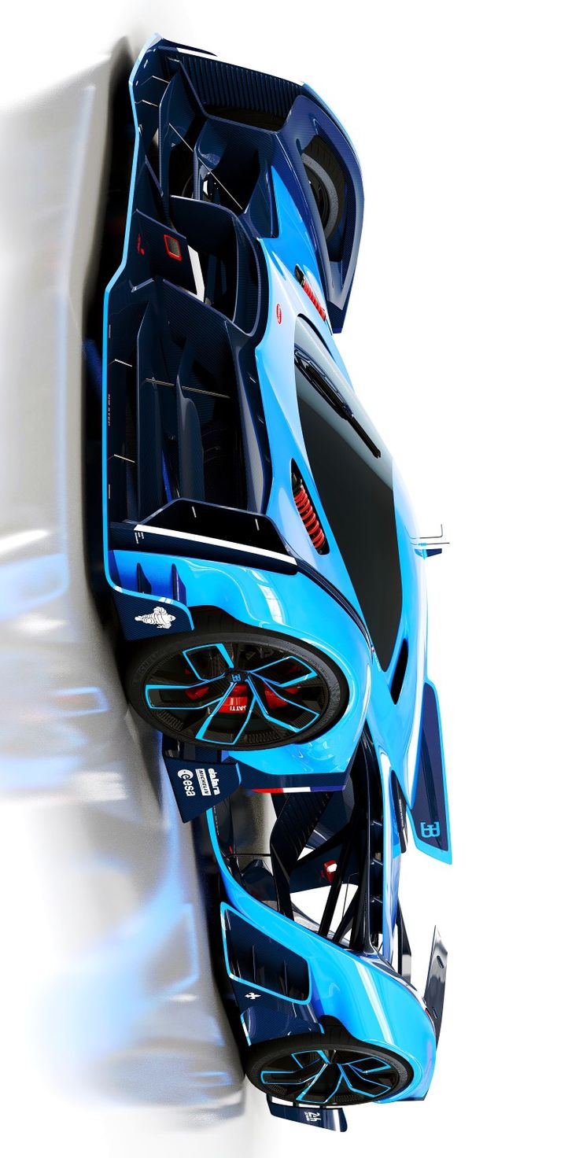
Brand Analysis and Comparison
High Performer:
Mercedes-Benz S-Class
(Score: 39.5/40)
Low Performer:
Audi A8
(Score: 37.5/40)
Moderate Performer:
BMW 7-Series
(Score: 38.5/40)
Strengths: Exceptional performance, luxurious features, high reliability, excellent conformance
Weaknesses: None significant
Strengths: Luxurious features, good conformance
Weaknesses: Lower performance, less advanced features, lower reliability
Strengths: Excellent performance, luxurious features, good reliability - Weaknesses: Lower conformance, less advanced features

Slide 7
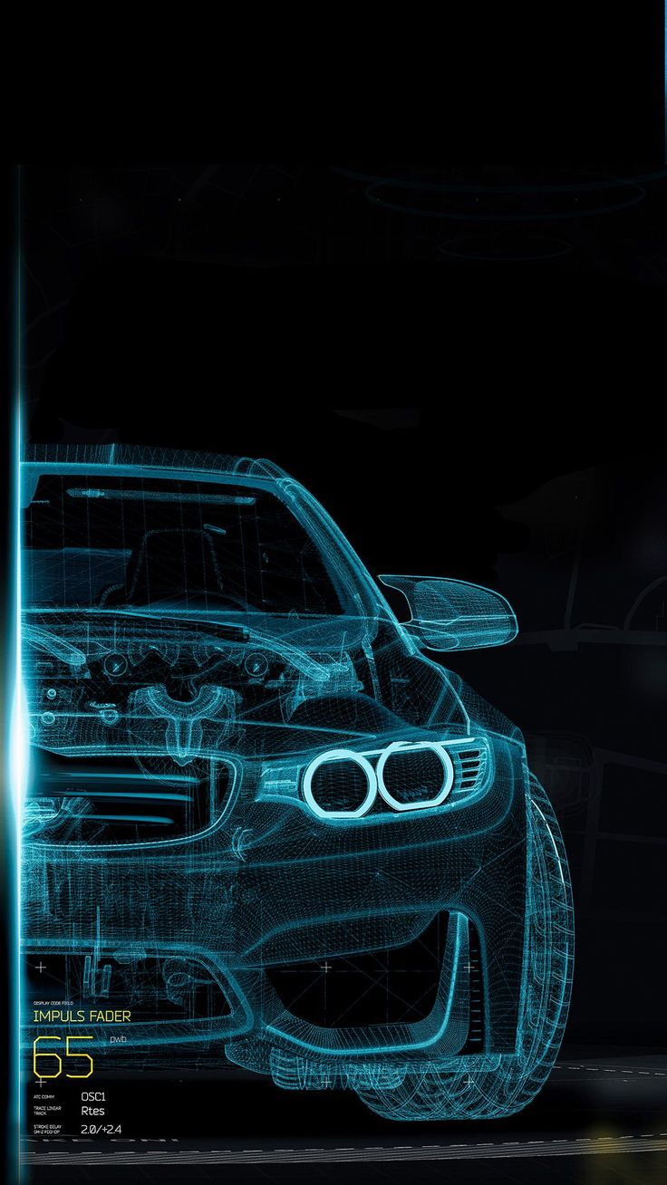

Discussion of Key Findings
Strengths
Weaknesses
Each brand's unique strengths cater to diverse customer preferences.
Brands show potential for enhancement in specific areas.
Trends
Opportunity
The luxury car market is evolving due to technological advancements and changing consumer needs.
The growing demand for EVs allows luxury carmakers to innovate and lead in the premium EV segment.
Notes:
• The key strengths of each brand in the luxury car market cater to diverse customer preferences, meeting the unique needs of different segments. • While the brands demonstrate strong capabilities, there are also areas with potential for enhancement that could further improve the customer experience. • The luxury car market is undergoing significant evolution driven by technological advancements and changing consumer demands. It's important to stay attuned to these market trends. • In addition to the strengths and weaknesses identified, the analysis also uncovered several opportunities for the brands to capitalize on and strengthen their competitive positioning.

Slide 8
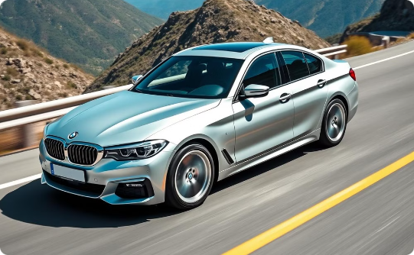
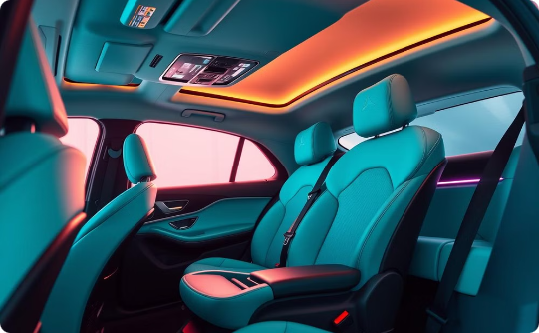
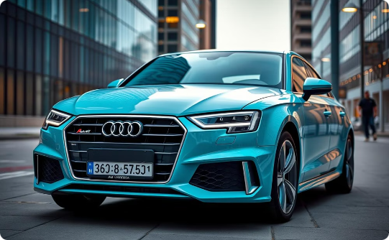
Strengths and Weaknesses
BMW
Mercedes-Benz
Audi
Strong performance, innovative technology, and sleek design. Less comfortable than rivals.
Luxury, comfort, and safety are strengths. Performance can lag behind competitors.
Well-rounded package, but reliability can be inconsistent.

Slide 9





Conclusion and Recommendations
Identify Needs
1
Prioritize your individual preferences and requirements.
Research Brands
2
Thoroughly evaluate each brand's strengths and weaknesses.
Test Drive
3
Experience the driving dynamics and comfort firsthand.
Compare Prices
4
Consider the total cost of ownership, including maintenance and insurance.
Make Informed Decision
5
Choose the brand that best aligns with your needs and values.

Slide 10

THANK YOUU!

